Slide 1
Predicting Perioperative Hyperglycemic Incidents
Nishant Velagapudi
W207 – Final Project Presentation
8.6.2018

Slide 2
Introduction
Perioperative care: care in operating rooms
Expensive: average cost of $62 per minute¹
Hyperglycemia: blood glucose levels too high
“Stress hyperglycemia”
Longer stays, higher mortality/morbidity²
Defined as a blood glucose level over 140 (mg/dl)
Treated through insulin
Macario, A. What does One Minute of Operating Room Time Cost? J. of Clinical Anesthesia, Vol. 22, 2010. Available online July 2013.
Duncan, A. Hyperglycemia and Perioperative Glucose Management. Curr Pharm Des, Vol. 18 (38). 2012.

Slide 3
Problem set up
Three possible outcomes per surgery
No incident (peak glucose < 140 mg/dl)
Hyperglycemic incident (140 mg/dl < peak glucose < 180 mg/dl)
Severe Hyperglycemic incident (peak glucose > 180 mg/dl)
Aim: predict which patients are at risk of high blood glucose during surgery

Slide 4
Notable techniques
Hyperparameter sweeps
Discover best parameters using cross validation
Cross algorithm comparison
Discover best algorithm
Topic modelling
Using LDA to transform/featurize text
Variable selection based on variable availability:
Predictions based on only demographics (patient upon admittance)
Predictions based on all variables (patient during surgery)

Slide 5
Approach
Classification (3 class)
Classifiers on each subset of data
Classifiers over all data
Regression
Pruned high leverage points

Slide 6
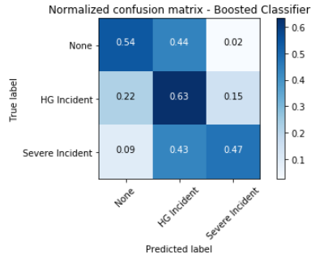
Best result: XGB tree over all data
Rarely predict a severe incident when there was no incident of hyperglycemia
Rarely predicted no incident when there was a severe incident of hyperglycemia

Slide 7
Live notebook demo
Please see FinalProject_Notebook.ipynb for full inline report

